Slide 1
Mobile Controlled Car
ECE 544 Final Project Progress Presentation
Ram Bhattarai
Ming Ma
Zhe Lu

Slide 2
Project Description
A Mobile Controlled car with forward, Reverse, Left and Right Motion. The car is mainly controlled by Nexys A7 board. We use UART to communicate between Nexys A7 board and NodeMCU Wifi module. This Wifi module will send data to or receive data from the firebase database to achieve the communications between Android App and Nexys A7 board.

Slide 3
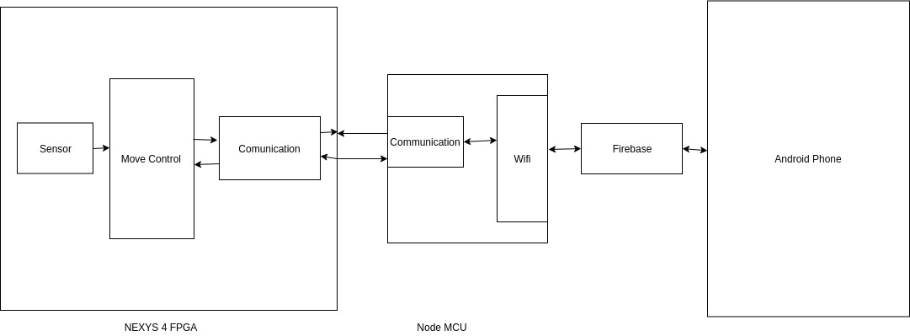

Slide 4
Achievements
We assembled the car model.
We tested the distance sensor code.
We tested the NodeMCU Wifi Module.
We tested the controller of the two motors.
We tested the UART communication between NodeMCU and Nexys A7 board.
Software control code for the car.
Integrate NodeMCU Wifi Module with Nexys A7 board and firebase database.
Integrate distance sensor with Nexys A7 board.

Slide 5
Hardware
Nexys A7 board
2 DC Motors
2 Pmod HB3
Car
Wifi Module(NodeMCU)
Android Phone
Android App
2 Distance Sensor

Slide 6
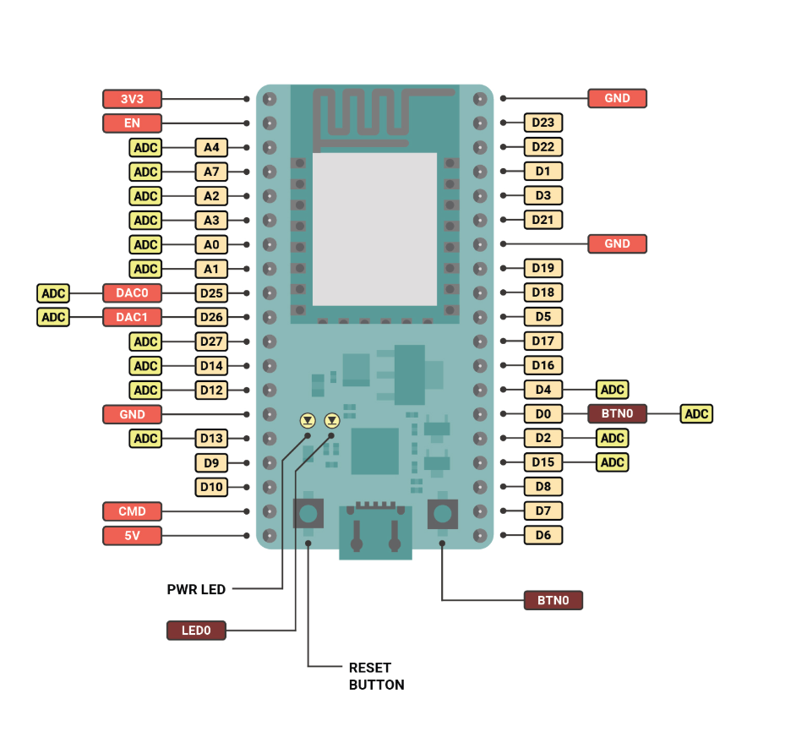
NodeMCU WIFI Module
Wifi Module that sets up wifi interface for firebase.
NODEMCU listens for update from firebase and sends data to Nexsys A7 using Uart communication protocol.
NODEMCU also listens to feedback from the Nexsys A7 current car state.

Slide 7
UART Communication
UART Communication protocol is used in this project for sending and receiving data from NODEMCU & NEXSYS A7.
Any changes to firebase will be send to NEXYS A7 using Uart from NODEMCU.
Current car state will be send to NODEMCU from NEXSYS A7 for Firebase update.

Slide 8
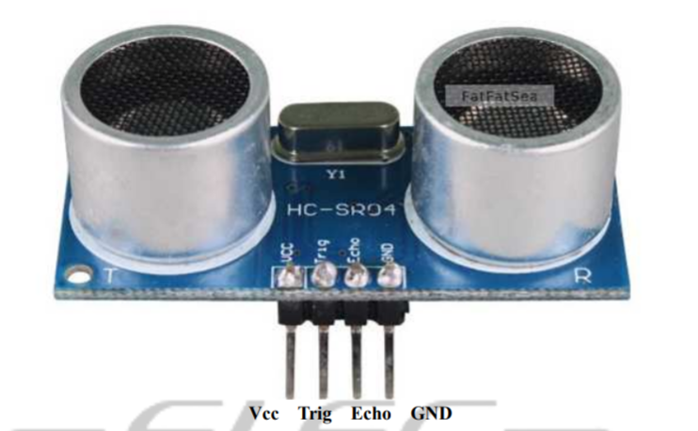
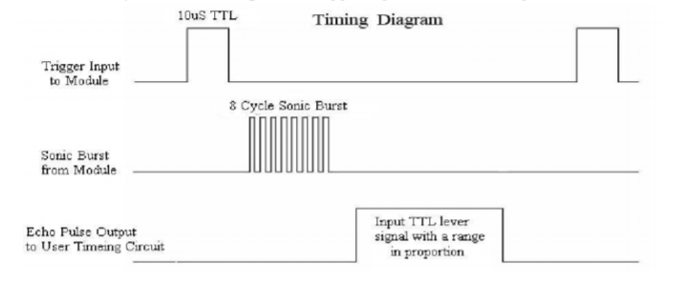
Distance Sensor(HC-SR04)
When Echo==1, Count how long this Echo signal is high(high_count).
Distance(cm) = (high_count / (10^8)) * 340 * 100 / 2
IP:ourDistanceSensorv4_1.0

Slide 9
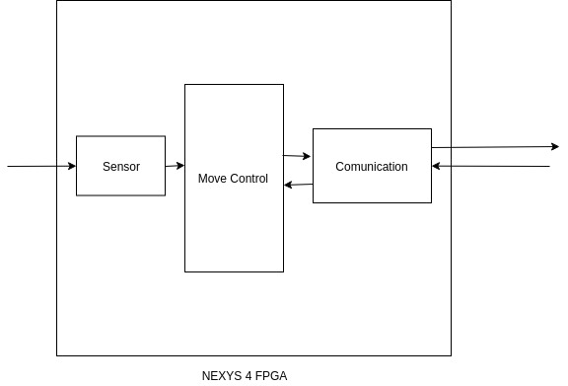
Software
Communication with NodeMCU
Read Sensor
Movement Control
Game Logic

Slide 10
Problems Faced and Solved
Distance sensor was not working properly. The voltage we used is 3.3V, but the distance sensor requires 5V voltage. Also, the measurement cycle should be greater than 60ms(period to measure Echo).
Battery running out of power.
NODEMCU- Uploading Issue
UART Communication: We don’t know what was the issue, but we created new embedded system project and everything magically worked.

Slide 11
Stretch Goals
3D Printing for Car Cover
Gesture Control for Car
https://drive.google.com/file/d/1Np2c2ZnPdm7rj0QJS31xIa3CdhXejwQy/view
Obstacle Alert(Sound)

Slide 12
Thank You!

